Slide 1
Sarvalanche -S1 Avalanche Detection Pipeline
Dr. Zachary Hoppinen

Slide 2
What is sarvalanche
Python package that handles data finding, reprojection, differencing, and detection for avalanche debris
How does it work? Combines static probabilities of avalanches debris (slope, fcf, runout probability) with SAR features (local resolution weighted backscatter change currently)
IO – we get S1 (opera rtcs, local resolution), forest cover, slope angles, UCLA snowmodel SWE, and run the FlowPy debris flow model over a dem to generate runout cell counts.
Runtime – over most of Sawtooth Mountains full run (including flowpy modeling (95% of time) takes about 30 minutes. Non-flowpy time = 5-10 minutes, data-loaded already = 1 minute.

Slide 3
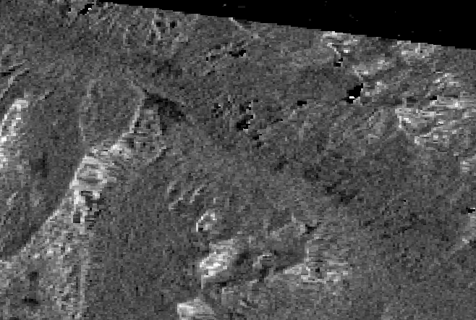
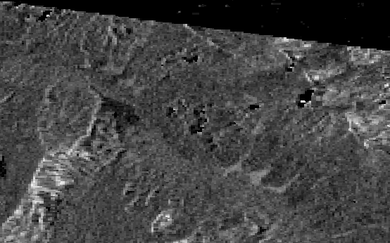
Example
March 31st – Major earthquake triggered avalanche cycle in the sawtooths
Avalanches – April 5th – Track 71
Before – March 30th – Track 71

Slide 4
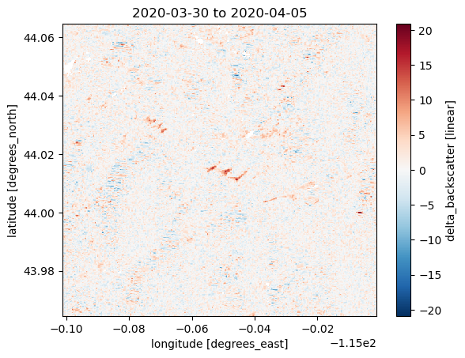
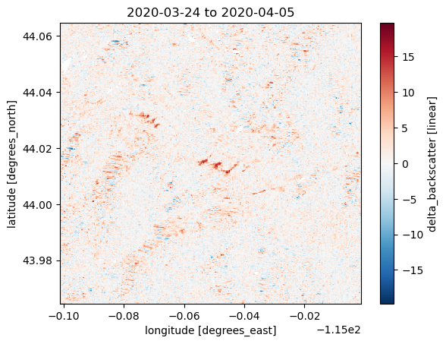
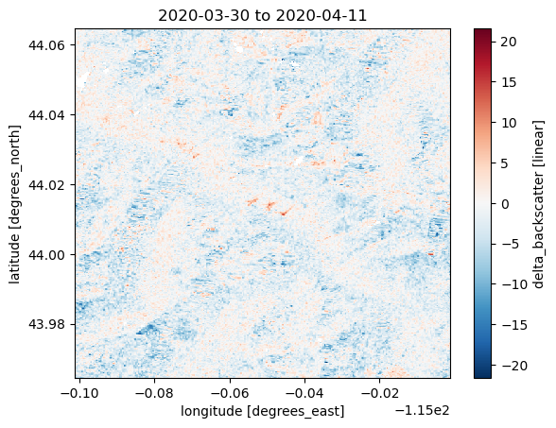
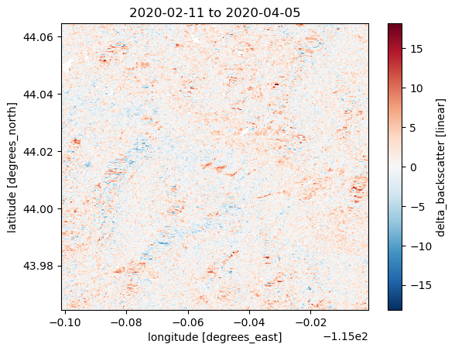
We start with dB of backscatter change over specific date (2020-03-31) from each track from all possible pairs (within a few months)

Slide 5
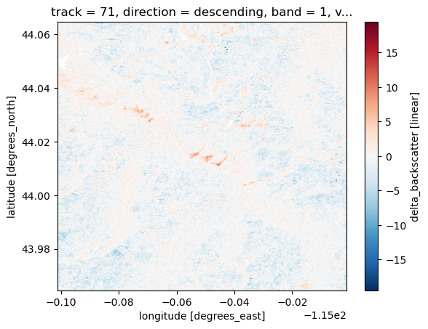
These are weighted by temporal distance between each pair to generate a track based mean change that weights closer pairs more
w_temporal = np.exp(-np.abs(dt_days) / tau_days)
With tau_days = 24 currently

Slide 6
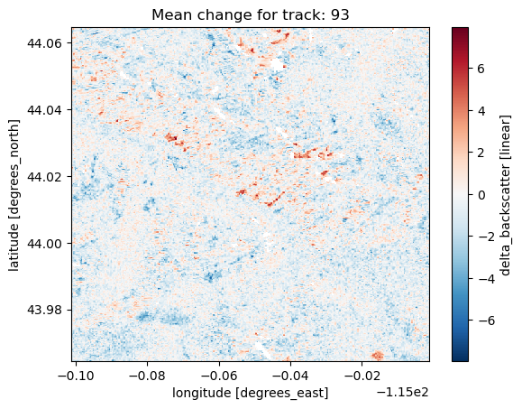
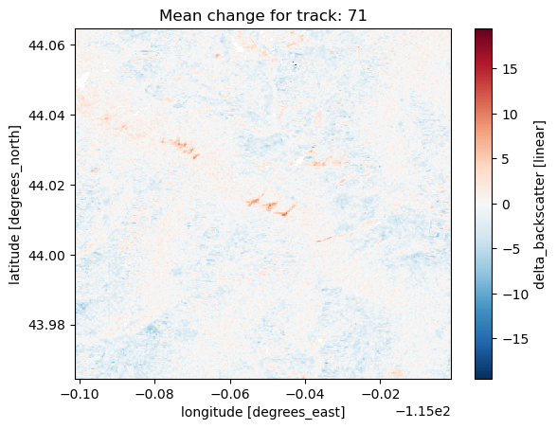
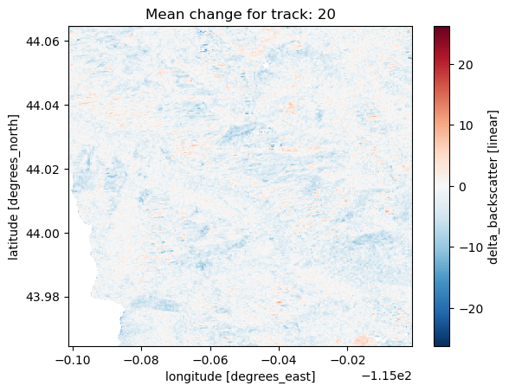
This is repeated for all available tracks

Slide 7
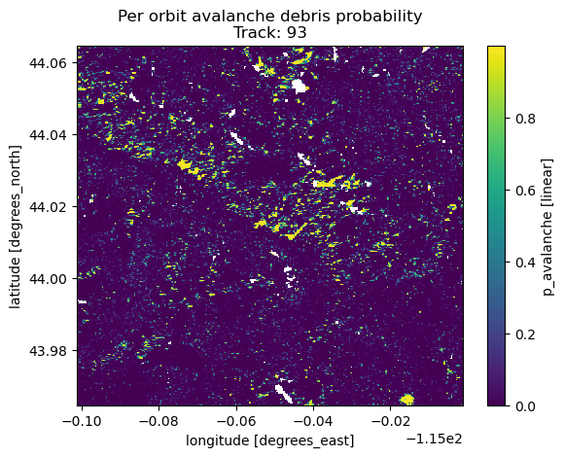
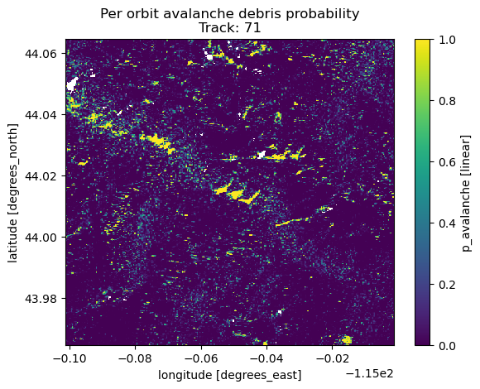
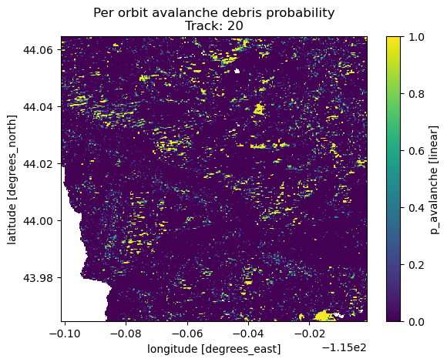
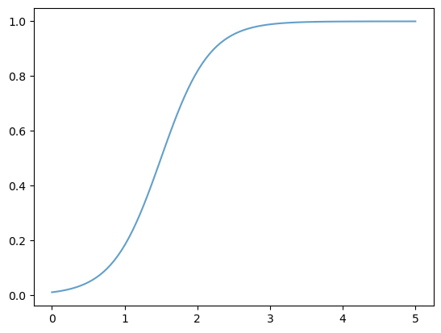
We convert this mean change to a probability
prob = scipy.expit(diff - threshold_db)*logistic_slope
We show the probability to backscatter change to the right

Slide 8
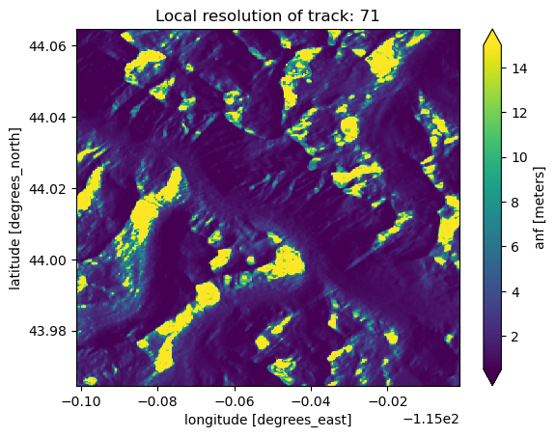
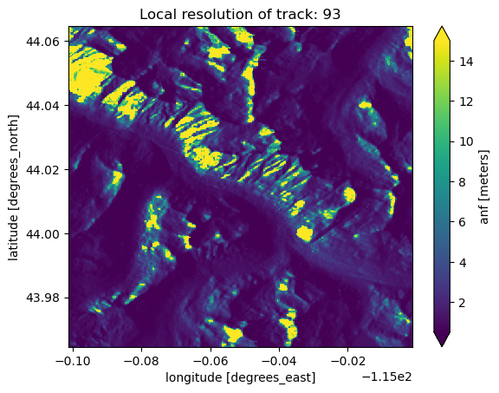
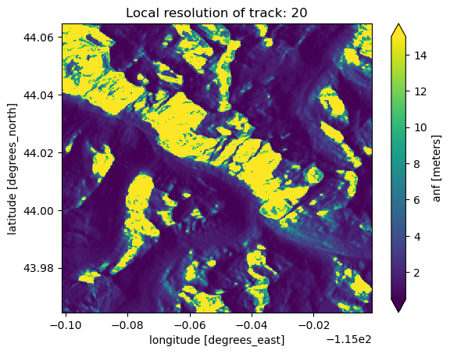
These are then combined using the inverse of local resolution of each pixel to weight the relative tracks.
So lower local resolution == less weight for final probability
We also use a relative weighting of VV vs VH (1.0 vs 0.8)

Slide 9
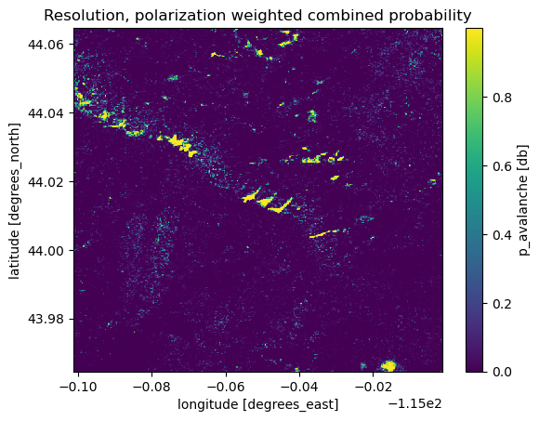
Combining probabilities from multiple tracks
Log-odds combination
log_odds = np.log(probs_safe / (1 - probs_safe))
# Weighted average in log-odds space
log_odds_combined = (log_odds * weights).sum(dim=dim)
# Convert back to probability
p_combined = 1 / (1 + np.exp(-log_odds_combined))
Boosting:
probs_filtered = probs.where(probs >= min_prob_threshold)
# Count valid sources (how many detect something)
n_valid = probs_filtered.notnull().sum(dim=dim)
n_total = probs.sizes[dim]
# Agreement: fraction showing detection
agreement = n_valid / n_total
# Boost formula: p_final = p_mean + (1 - p_mean) × agreement² × strength
boost = (1 - p_combined) * (agreement ** 2) * agreement_strength
p_combined = p_combined + boost

Slide 10
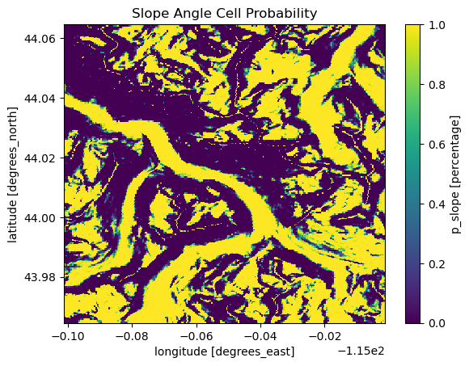
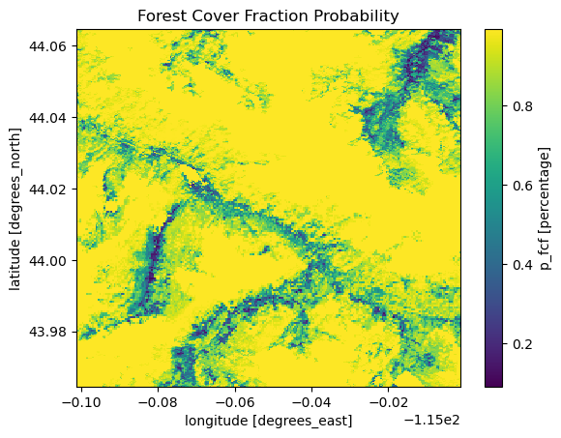
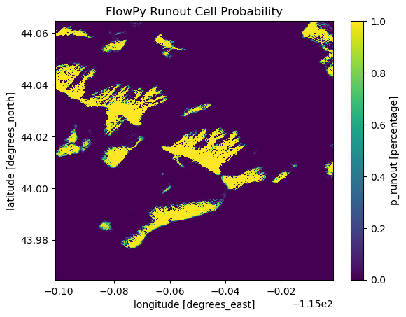
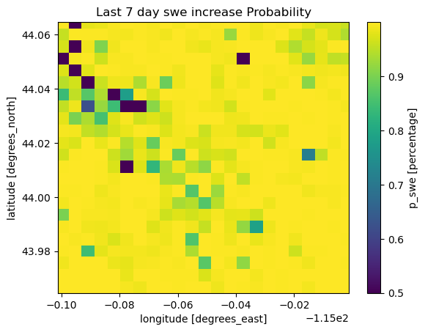
This is then combined (geometric mean this time) with non-SAR probabilities

Slide 11
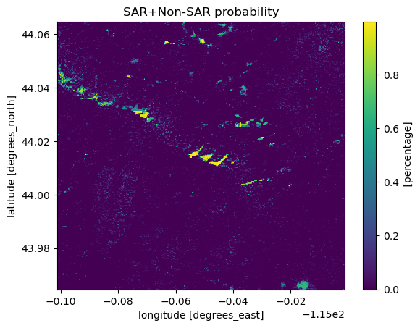
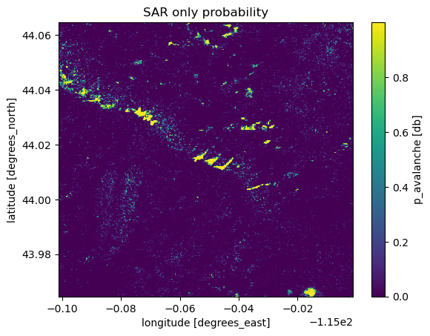
We just multiple pooled non-SAR probabilities * SAR probability.
In this case it actually increased probability since many of these are: 1. in runout zones, 2. low angle, 3. no fcf, 4. lots of recent SWE.
But for regions and times (not this example) with low recent SWE accumulation, not in runouts, in trees, or at steep angles this will lower probs.

Slide 12
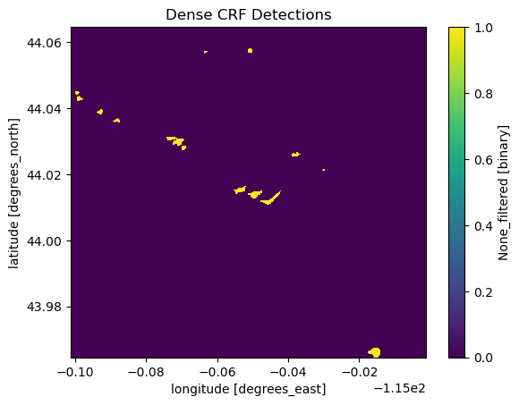
Last step: Use dense conditional random fields to give weight to pixels near other debris pixels and remove sharp changes in debris/background

Slide 13
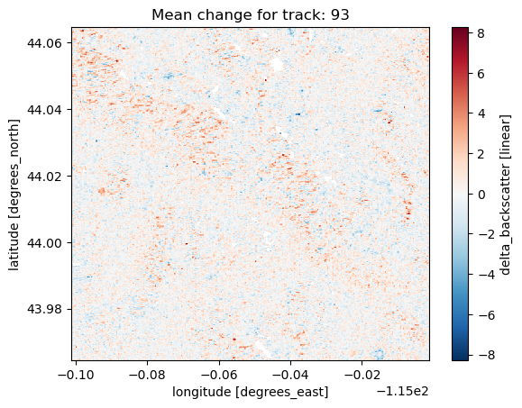
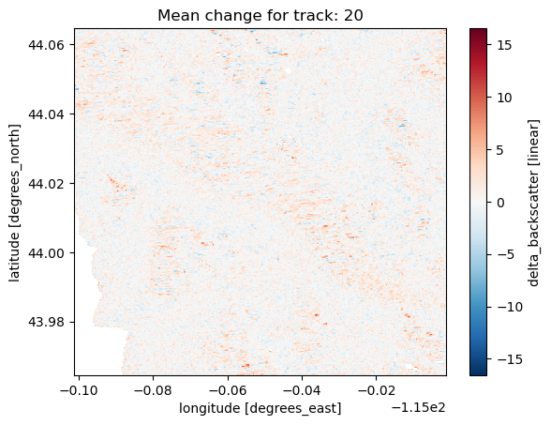
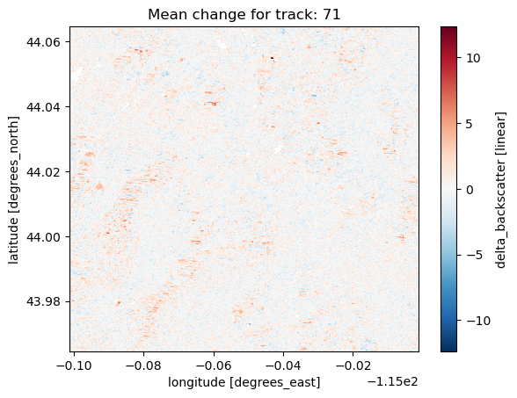
Re-run again on Jan 31st, 2020 for an example of minimal avalanches

Slide 14
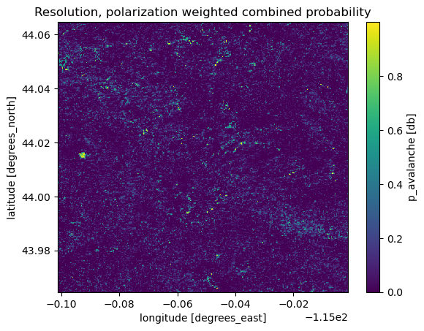
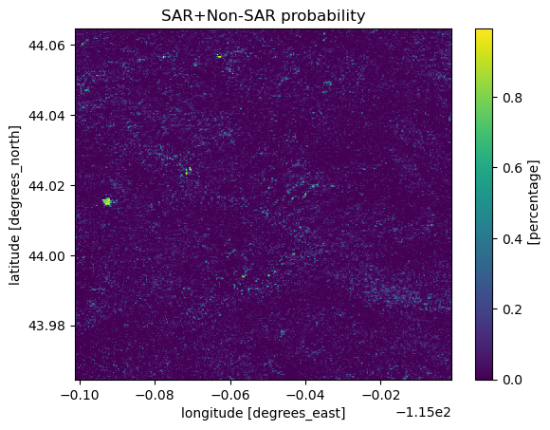
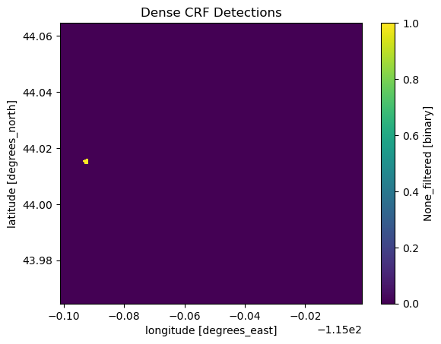
Re-run again on Jan 31st, 2020 for an example of minimal avalanches

Slide 15
Next Steps?
ISSW presentation – run over last 5 years over each of the western US avalanche regions to generate database for other researchers. What level of temporal specificity? Yearly? Monthly? Daily?
Processing improvements:
Multi-temporal. When does an avalanche first appear in a SAR scene = set as detection date.
Use backscatter distributional changes in addition to backscatter change
Use empirical detections to train ML model (unet) and capture more detections
Incorporate other/more sentinel-1 coherence and NISAR based pixel based probability pipelines.

